Slide 1

the Perinatal Period:
Problems and Possibilities
Mills Peninsula Hospital
Department of Psychiatry Grand Rounds
March 18, 2014
Helen Marlo, Ph.D.
Professor, Interim Chair, Notre Dame de Namur University,
Clinical Psychology Department
Psychologist (PSY 15318), Psychoanalyst
Founder, Emergence: Reproductive Mental Health Services
helen@helenmarlophd.com

Slide 2
Acknowledgements
  Thank you to:
Ms. Tiffany Girouard
Masters of Science in Clinical psychology Student, MFT/LPCC Program; Notre Dame de Namur University
for providing valuable research assistance

Slide 3
Influences on the Perinatal Period:
“The neurosis is as a rule a pathological, one-sided development of the personality, the imperceptible beginnings of which can be traced back almost indefinitely into the earliest years of childhood. Only a very arbitrary judgment can say where the neurosis actually begins. If we were to relegate the determining cause as far back as the patient’s prenatal life, thus involving the physical and psychic disposition of the parents at the time of conception and pregnancy—a view that seems not at all improbable in certain cases—such an attitude would be more justifiable than the arbitrary selection of a definite point of neurotic origin in the individual life of the patient” (Jung, CW 16, 257-258).

Slide 4
Psychology of the Perinatal Period
Time of personal reorganization, transition, and development:
Psychologically, Physically, culturally, socially, relationally.
Involves a normal period of increased anxiety, reevaluation of life, and the emergence of unconscious conflict.
upheaval may encourage self-evaluation and sensitive care to newborn (Klaus, Kennel, & Klaus, 1995).
“The ghosts in the nursery” experience (Fraiberg, 1975): The phenomena whereby a parent’s unconscious memories of her childhood experiences impact her parenting style.
Increased physical and psychological stressors
  physical and psychological stressors increase inflammation. Puerperal women especially vulnerable because proinflammatory cytokines significantly increase during the last trimester. common experiences of new motherhood: sleep disturbance, postpartum pain, and past or current psychological trauma, are stressors that cause proinflammatory cytokine levels to rise (Kendall-Tackett, 2007).

Slide 5
Psychology of the Perinatal Period
When a baby is born, a mother is born: Time of “Maternal Rebirth” (Stern, 1988)
  shifts in roles
  encountering a different form of love
  experiencing one’s partner in new ways
  heightened awareness of, and change in, gender roles
  developing a new identity
  reevaluating lifestyle, goals, and priorities
  reconciling work-family demands
  an awakening or reawakening of early childhood issues especially one’s relationship to her mother

Slide 6
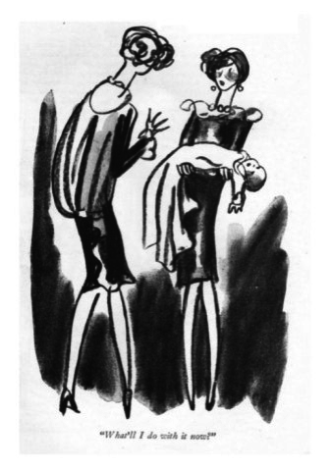
Developmental Considerations: Transitioning to Motherhood
"What’ll I do with it now”

Slide 7
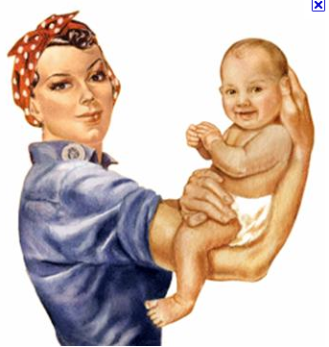
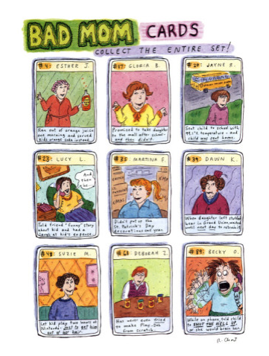
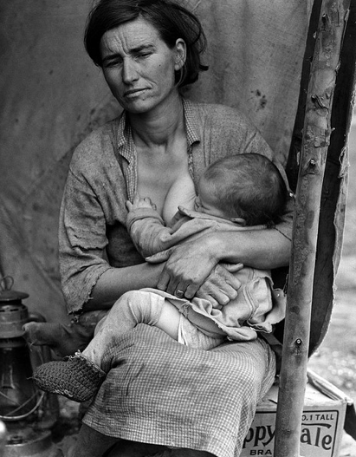
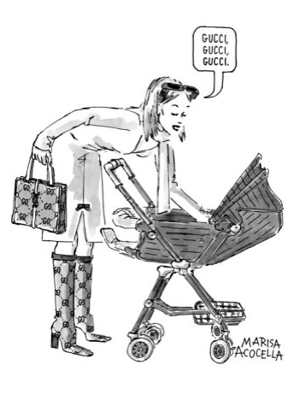

Birth into motherhood is filled with personal evaluation and powerful myths, images and expectations, that are often sanctioned by cultural assumptions about motherhood and “good mothers:”

Slide 8
TRANSITIONING TO MOTHERHOOD:
“The mother having been a child and having introjected the memory traces of being… cared for…relives with her infant the pleasures and pains of infancy…Parents meet.. not only the projections of their own conflicts incorporated in the child, but also the promise of their hopes and ambitions.” (Benedek, 1959)
“Motherhood is earned first through an intense physical and psychic rite of passage—pregnancy and childbirth—then through learning to nurture, which does not come by instinct.” (Rich, 1995)
Motherhood is characterized by paradox, contradictions, and opposites (deMarneffe, 2004; Maushart, 1999; Raphael-Leff, 1993)
⬥ Mothers feel love and hatred towards their children
⬥ Motherhood is marked with profound gains and losses.
⬥ Motherhood is revered and devalued.
⬥ Mothers are powerful and powerless.
⬥ Motherhood is instinctive and natural yet profoundly difficult and complex.
⬥ Mothers can have innate capacities for nurturing and yet sustained nurturance over time is learned.
⬥ Mothers may feel instantly connected with their child (or disconnected)
yet genuine bonding and attachment is a long-term process.

Slide 9
➢Pregnancy and birth is often a time of maternal rebirth. A vulnerable time, it triggers a process of self-reorganization and personal evaluation. (Stern, 2002).
Imagined mother meeting real mother: Will I be like my mother? Will I be better or worse than my mother/parents? Will I replicate my childhood?
Imagined baby meeting real baby: “good” or “bad;” divine or devil; flawless or deformed
Imagined birth meeting real birth: perfectly as planned; “perfectly” natural or “perfectly” medicated; completely in control or completely out of control
Imagined baby’s effect on mother meeting real effect: unconditional love; replacement baby; antidepressant; conciliator for family of origin; restoring and stimulating new relationship with mother; escaping the destiny of one’s past
Imagined baby’s effect on marriage meeting real effect: marital glue or marital threat
Imagined family meeting real family: baby as carrier of flaws; baby as gift; role in family mythology; baby as agent for social/psychological mobility

Slide 10

TRANSITIONING TO PARENTHOOD:
⬥ Marital conflict increases dramatically, and marital quality decreases
for 40-67% of couples within the first year of baby’s life.
“Bringing Baby Home” program decreased postpartum
depression (22.5% versus 66.5% in control group) by
targetting couples relationship, educating on infant development,
involving fathers in infant care.
(Shapiro & Gottman, 2005).

Slide 11
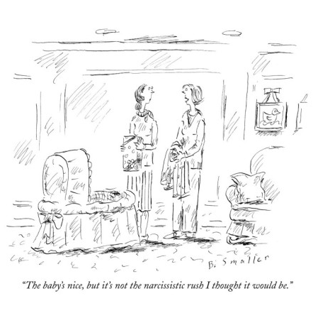
Psychological Struggles in the
Perinatal Period
Personality Characteristics and Patterns:
Attachment Patterns
Perfectionism
High Expectations
Critical
Obsessive
Compulsive
Rigidity/inflexibility
Jealous
Helpless/dependent
Self-reliant/independent
Avoidant
Overinvolved
controlling
Self-negligent
Self-absorbed
“”
The baby’s nice, but it’s not the narcissistic rush I thought it would be.

Slide 12
Perinatal Struggles
Perinatal Struggles:
Normal, universal, challenging, and influential part of developmental process.
Severity is on continuum. Significant struggles occur in over 25% of women and often co-occur in partners and children.
Up to 75% of mothers of preschoolers report anxiety and feelings of entrapment while 27% experience some kind of anxiety disorder (Schreier, 2008; Maushart, 1999). Between 30-80% of mothers complain of depression while 10-15% develop a mood disorder (Beck, 2001; Maushart, 1999).
Increased pregnancy fears and anxiety, not general stress, relates to pre-term births—elevated corticotropin-releasing hormone may stimulate birth (Dunkel-Schetter & Mancuso, 2010)

Slide 13
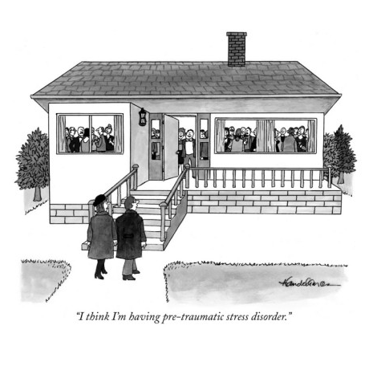
Psychological Challenges in Perinatal Period:
⬥ anxiety
⬥ Trauma including Post-Traumatic Stress Disorder
⬥ Bonding and Attachment Problems:
• Detached or overly, inconsistently, or chaotically attached
⬥ Developmental challenges and transitions
⬥ Grief and loss
⬥ Depression
⬥ Relationship/Marital/Partner Issues
⬥ Unresolved Past Issues
⬥ Concerns about Parenting
⬥ Pregnancy Related Concerns
⬥ Psychosomatic Problems
⬥ Eating Disturbances
⬥ Substance Abuse
⬥ Addictions
I think I’m having pre-traumatic stress disorder

Slide 14
Factors Associated with Perinatal Distress
Physical factors:
    Previous psychiatric history and care
    Physical problems: thyroid, hormones, nutrients, neurotransmitters, anemia
    Fatigue and disrupted sleep
Socio-cultural factors:
    Inadequate social/cultural/familial recognition
    Absence of traditions/rituals
    Insufficient social support and social isolation
    Socioeconomic problems
Birth and Infant Factors:
    History of obstetric problems and treatment for infertility, stillbirth, or miscarriage
    Difficult or traumatic pregnancy, labor or birth
    Twins and multiple births
    Discrepancy between expectations and subsequent experience
    Disappointment with birth and birth professionals
    Problems with infant
    Infant characteristics especially when poor match with mother
    Complications, dissatisfaction, or disliking breastfeeding

Slide 15
Factors Associated with Perinatal Distress
Psychological Factors:
    Poor relationship with partner/marriage
    Negative perceptions of parental care during one’s childhood
    Poor relationship with parents
    Absent/poor mother-daughter relationship
    Less paternal involvement and support of infant’s care
    Ignorance of infant development
    Distorted self-esteem and self-efficacy (high or low)
    Unrealistic expectations
    Lack of satisfaction with educational or professional achievement
    Little previous contact with babies
    Prolonged conception period
    History of sexual or physical trauma and abuse
    Fear of childbirth
    Unresolved traumas or losses
    Stressful events
    Maternal age (younger and older)
    Lack of control over returning to work
    Parenting style

Slide 16
PERINATAL POST-TRAUMATIC STRESS SYMPTOMS/DISORDER
RISK FACTORS:
(Garthus-Niegel, 2013; Beck, 2011; Waldenstrom 2004; Soet, 2003;Creedy, 2000; Thom, 2007; Soderquist, Wima 2002; Olde 2005: Ayers, 2007; Gamble, 2005; Gross, 2005; Cigoli, 200)
⬥ Subjective birth experience
⬥ Unexpected medical problems
⬥ Unplanned pregnancy
⬥ High level of obstetric intervention
⬥ Cesarean birth especially planned cesarean
⬥ Pressure to have labor induced or pressured into epidural
⬥ Perception of inadequate labor support
⬥ Instrumental delivery
⬥ Infant in NICU
⬥ Poor experience with pain
⬥ Lack of choice and loss of control over labor
⬥ Unmet expectations especially without explanation
⬥ Negative interactions with hospital professionals and staff
⬥ Poor partner support
⬥ Feelings: powerless, alone, defeated, thoughts of death
⬥ Prenatal depression and anxiety
⬥ Traumatic life events and (childhood) sexual trauma history
⬥ Dissociative Tendencies or Dissociation
⬥ Prenatal depression and anxiety
⬥ Negative reactions to breastfeeding or minimal/no
breastfeeding

Slide 17
PERINATAL ANXIETY, TRAUMA, & POST-PARTUM POST TRAUMATIC STRESS SYMPTOMS/DISORDER (PTSS/PTSD):
➢An experience of childbirth where one believes her life or her baby’s life was threatened; and includes feeling helpless, out of control, alone, and unsupported.
significant, negative, long-term impact on patient: mood, behavior, relationships, sexuality, relationship with physician, future pregnancy and childbirth, mother-baby bonding and attachment, and breastfeeding.
Rates of postpartum post-traumatic stress disorder range from 1.5-9%.
  Between 25%-34% of women report traumatic births and 1.5-3% of
  women with normal births developed PTSD (Soet, et al, 2003, Creedy,
  et al, 2002, Czarnocka, et al, 2000, Beck, 2005, 2006, Ayers, 2007).
Women who develop PTSD following a traumatic event prior to or during pregnancy are at greater risk of pTSD/PTSS after childbirth (Ayers, et al. 2009; Cohen et al. 2004).
➢Fear of childbirth before delivery is risk factor for ptss after childbirth

Slide 18
PERINATAL ANXIETY, TRAUMA, & POST-PARTUM POST TRAUMATIC STRESS SYMPTOMS/DISORDER (PTSS/PTSD):
History of anxiety and depression in women associated with most severe traumatic stress responses (ayers, 2004).
Garthus-Niegel, et Al, (2013): Study of 1,499 women found
  Women’s subjective birth experience was the biggest predictor of post-partum post traumatic stress disorder.
  While objective factors contribute to postnatal trauma, the subjective appraisal of the birth is more significant.
  A review of 31 studies concluded it is common and under-recognized (Olde, 2005).

Slide 19
Perinatal Post-Traumatic Stress Disorder
  Nationwide study of 1,573 postpartum women found (Beck, 2011):
  9% met diagnostic criteria for PTSD
  18% had significantly elevated posttraumatic stress symptoms—PTSS
variables associated with higher ptss:
  Low partner support
  Elevated postpartum depressive symptoms
  More physical problems since giving birth
  Less health promoting behaviors
  Did not exclusively breastfeed one month after birth or breastfeed as long as desired.
        (Beck, et., Al, 2011)

Slide 20
Perinatal Posttraumatic Stress Disorder
Variables that significantly differentiated women with elevated ptss from those who did not:
  No private health insurance
  Unplanned pregnancy
  Pressure to have an induction and epidural analgesia
  Planned cesarean birth
  Consulted with a clinician about mental well being since birth
  Not breastfeeding as long as wanted
  Not exclusively breastfeeding at one month
        (Beck, et., Al, 2011)
“postpartum posttraumatic stress symptoms may develop following a negative childbirth experience. It frequently manifests when the childbirth experience is emotionally overwhelming, does not meet expectations, and kindles or re-stimulates sexual, physical, and emotional traumas” (Marlo, 2013).

Slide 21
Psychology of postpartum ptsd:
“Challenging or traumatic memories are more likely to emerge now, in part, from the unpredictable, painful, vulnerable, and intrusive dimensions that naturally occur with pregnancy, birth, and infancy” (Marlo, 2013).
They may be part of what psychoanalyst, Selma Fraiberg (1975), termed “the ghosts in the nursery” experience…the phenomena whereby a parent’s often, unconscious memories of her childhood experiences impact her parenting style.
Focusing on the “Ghosts in the Nursery” phenomena addresses how past experiences impact a mother’s ability to form an attuned relationship with her child, herself and/or her partner, now, and provides a basis for understanding unhealthy forms of relating in the parent-child triad (marlo, 2013).

Slide 22
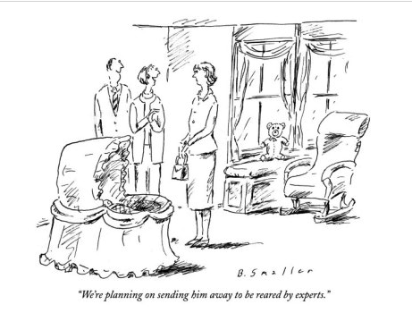
Developmental Considerations: Transitioning to Motherhood

Slide 23
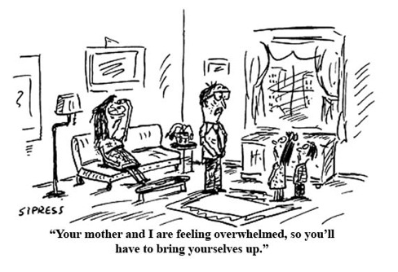

Slide 24
Intervention and Treatment
Incorporate an understanding of a woman’s biological, psychological, sociocultural, and spiritual development, and an understanding of the psychology of birth, pregnancy, and motherhood.
  www.Emergencementalhealth.com
Preventive care: Preparation before/during pregnancy. Address family of origin issues, unresolved traumas, losses, relationship patterns.
Professionally facilitated support groups have been especially helpful with perinatal problems (Jaffe & Diamond, 2011).
Integrative Treatment: Psychosocial and educational interventions, individual and group psychotherapy, medication, peer interventions, trauma therapies; somatic work and somatic psychotherapies; and integrative/complementary medical and psychological treatments including relaxation therapy, yoga, massage, mindfulness, meditation, and hypnosis are effective with perinatal problems (Jaffe & Diamond, 2011; Siegel, 2003).
Psychotherapy: Brief to long-term. May involve individual; parent-infant psychotherapy; couple; or family and include integrative or complementary treatments.

Slide 25
Intervention and Treatment
Women who struggle with a couple of issues are often responsive to self-help strategies or concrete interventions.
  support groups: Mentoring Mothers
  developing a relationship with a trusted health professional
  addressing nutritional depletion
  improving sleep
  natural remedies; herbs, supplements, and psychiatric medications
  yoga
  massage
  learning about infant development (in contrast to a parenting method) and involving the partner/father
  addressing marital/couples issues
  incorporating touch and massage; meditation
  practicing mindfulness
  developing emotional attunement and empathy
  enhancing emotional development and intelligence
  connecting with spiritual practices
  cultivating one’s creative imagination

Slide 26
Intervention and Treatment
Women who struggle more intensively may experience more healing from integrative, in-depth, professional treatment that includes individual or group psychotherapy.
  Promote an integrated approach to her health: Help target one area that is within her capacity to influence.
  Recognize PTSD symptoms: re-experiencing; avoidance; or arousal symptoms. Affirm benefits of earlier treatment to her and her child.
  address the “ghosts in the nursery.”
  Affirm the influence of “the reproductive story:” The, “at times conscious, but largely unconscious, narrative” created “about parenthood.” (Jaffe & Diamond, 2011) and the value of working mindfully with it.
  Name the healing power of telling her story. create a “coherent narrative.” An emotionally intense task, this differs from the life story a woman may readily know or tell.

Slide 27
Research on Reflectiveness, narrative, and Maternal adjustment:
⬥ The un-narrated past, not the past, impacts the present. Meets the
human need to be heard, seen, and valued.
⬥ A mother who develops and articulates a “coherent narrative” of
her life story has greater mental health, healthier parenting,
improved relationships with partner and children, and more secure
children with better interpersonal relations (Siegel, 2003).
⬥ Narration fosters neural integration of the right and left
hemispheres (Teicher, 2002), which leads to improved
emotional regulation, and more conscious choices.
⬥ Pregnant mothers who were self-reflective [“mentalizing”] about their early
histories and able to share a coherent story of their early life [“narrating”],
when three months pregnant, had less anxious children who demonstrated
secure attachment at eighteen months (Fonagy, et. al, 1993).
⬥ Mothers with significant adversity and deprivation, but high
reflectiveness ratings, demonstrated secure attachment relationships with
their children, while only one of seventeen deprived mothers, with low
reflectiveness ratings had secure children (Fonagy, Steele, Moran, Steele, and
Higgitt, 1991a)

