Slide 1
Teaching Analytical Psychology:
What Works, What Matters
C.G. Jung Institute of San Francisco
January 31, 2016
Helen Marlo, Ph.D.

Slide 2
Analytical Psychology and Teaching
Influential Teachers on Education
Relationship between Teaching & Practice
Connections with Analytical Psychology,
Training, and Clinical Practice

Slide 3
Influential Teachers: On Education
Notes:
Take one minute and reflect on a teacher who really touched you. Write down a few words that describe the qualities of the teacher that made him/her so influential.
My story: Marilyn, birthday party

Slide 4
Teaching Analytical Psychology: Tension: Practice vs. Teaching
Those who can, do, those who can’t teach.
Those who can’t do, teach.
            Originally penned by George Bernard Shaw (1903), “He who can, does. He who cannot, teaches.”)
Teacher/Teaching Complex
Teacher Archetype
Transference/Countertransference Issues
Notes:
Will look at ideas about teaching but before that—a few words about teaching and practice. Devaluation of good teaching; an art and skill to teaching.
Tension between clinical psych/psychiatry/medical model and academic or learning/educational model” Philosophically often seen as incompatible. Devaluation on each side.
There is something that needs to be healed versus something that needs to be learned
Teacher complex: authority; achievement
Teacher archetype: Transmission—knowledge, understanding, experience; mentoring
Clinician: Diagnosing, treating, healing

Slide 5
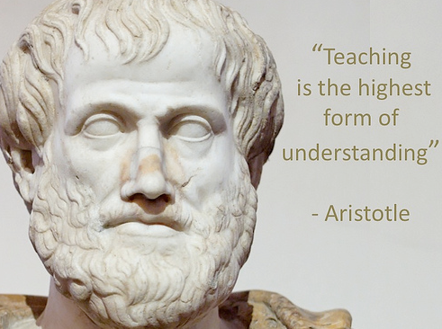

Slide 6
Aristotle:
Expresses (Ethical) Philosophy of Life
Associationism: Law of Contiguity; Frequency; Similarity; Contrast
Habit: “Anything that we have to learn to do we learn by the actual doing of it...’ (Niconachean Ethics, Book II, p.91).
Integrative
Body—Mind---Soul
Theoretical, Practical, Technical

Slide 7
Aristotle
“The educated differ from the uneducated as much as the living differ from the dead.”
“Educating the mind without educating the heart is no education at all.”

Slide 8
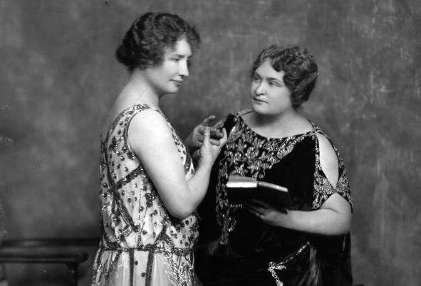
It is a rare privilege to watch the birth, growth, and first feeble struggles of a living mind; this privilege is mine. Anne Sullivan

Slide 9
Anne Sullivan:
Empathy
Personal Experience
Relationship
Development and Transformation
Sensory
Somatic

Slide 10
Anne Sullivan
“The processes of teaching the child that everything cannot be as he wills it are apt to be painful both to him and to his teacher.”
“Education in the light of present-day knowledge and need calls for some spirited and creative innovations both in the substance and the purpose of current pedagogy.”

Slide 11
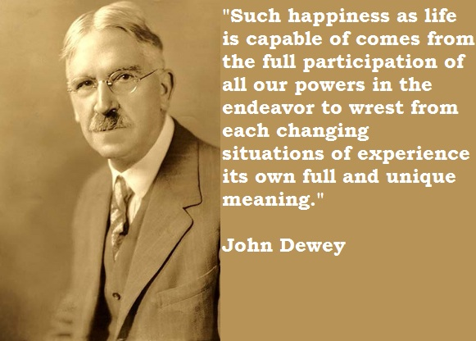

Slide 12
John Dewey:
    Balanced role of student; teacher; content
    Passion for knowledge; inherent curiosity; love of learning: Internalized, unconscious principles (not mechanical skills)
    Learn by doing: Hands on—Pragmatism
    Intelligent Inquiry: Theory and practice
    Direct Experience; Reflection
    Interdisciplinary

Slide 13
“The belief that all genuine education comes about through experience does not mean that all experiences are genuinely or equally educative.”
John Dewey
“We do not learn from experience…we learn from reflecting on experience.”
John Dewey

Slide 14
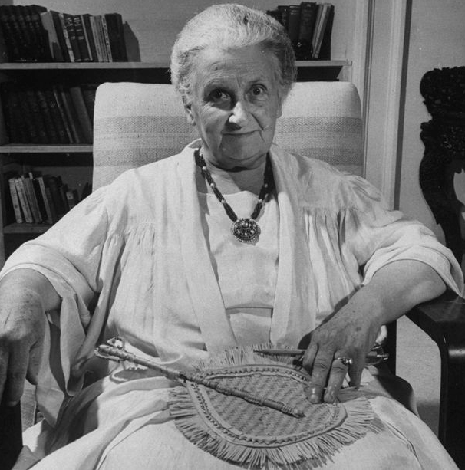
“It is not enough for the teacher to love the child. She must first love and understand the universe. She must prepare herself, and truly work at it.”
―Maria Montessori

Slide 15
Maria Montessori
Individualized/Independent
Curiosity and Imagination
Natural Spirituality
Personal Development
Structure with Freedom
Process Oriented

Slide 16
Maria Montessori:
“If an educational act is to be efficacious, it will be only that one which tends to help toward the complete unfolding of life. To be thus helpful it is necessary rigorously to avoid the arrest of spontaneous movements and the imposition of arbitrary tasks.”

Slide 17
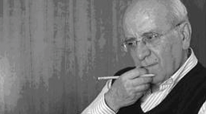
Carl Rogers: Clinician and Academic
In responding to expressions in the classroom group, he accepts both the intellectual content and the emotionalized attitudes, endeavouring to give each aspect the approximate degree of emphasis which it has for the individual or the group.
Notes:
Father of humanistic psychology—departure from academic psychology and pathologically focused clinical model of psych

Slide 18
Carl Rogers
Whole Person: Feelings and Intellect
Learn the Process of Learning
Openness to Experience and Incorporating Change
Personal Relevance and Necessity
Organize and Provide Resources
Instructor (Facilitator) Share Him/Herself: Thoughts and Feelings

Slide 19
Carl Rogers: On Teaching (Facilitating)
Self initiated learning which involves the whole person of the learner—feelings as well as intellect—is the most lasting and pervasive.
The most socially useful learning in the modern world is the learning of the process of learning, a continuing openness to experience, and incorporation into oneself of the process of change.

Slide 20
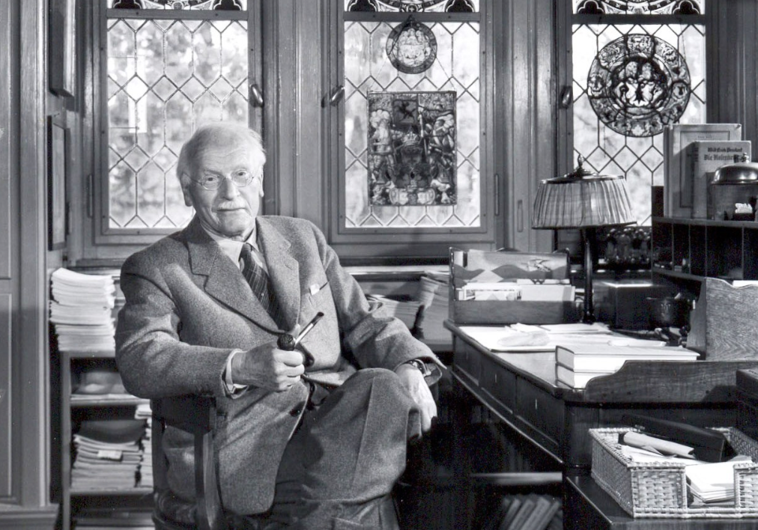
“…good example still remains the best pedagogic method…” (Jung, CW 17, 107).

Slide 21
Carl Jung:
Four Stages of Psychotherapy/Analysis (Jung, CW16):
  Confession/Catharsis
  Elucidation
  Education
  Transformation

Slide 22
Carl Jung
Regarding the “Education” Stage:
“…the crooked paths of a neurosis lead to as many obstinate habits, and that for all our insight these do not disappear until replaced by other habits. But habits are won only by exercise, and appropriate education is the sole means to this end. The patient must be drawn out of himself into other paths, which is the true meaning of “education,” and this can only be achieved by an educative will. We can therefore see why Adler’s approach has found favour chiefly with clergymen and teachers, while Freud’s approach is fancied by doctors and intellectuals, who are one and all bad nurses and educators. (Jung, CW, 16, 152).

Slide 23
Carl Jung
Regarding the “Education” Stage:
“Finally comes education, pointing out that no amount of confession and no amount of explaining can make the crooked plant grow straight, but that it must be trained upon the trellis of the norm by the gardener’s art. Only then will normal adaptation be reached.” (Jung, CW, 16, 153).

Slide 24
Carl Jung: On Adults and Education
“The adult is educable, and can respond gratefully to the art of individual education; but naturally his education cannot be conducted along the lines suitable to the child. He has lost the extraordinary plasticity of the child’s mind, and has acquired a will of his own, personal convictions, and a more or less definite consciousness of himself, so that he is far less amenable to systematic influence….The adult…feels himself to be the upholder of contemporary culture. He therefore has little inclination to submit to a teacher like a child…” (Jung, CW 17, ¶109).

Slide 25
Carl Jung: Education and Clinical Concerns
“At present we educate people only up to the point where they can earn a living…The solution of all the remaining complicated problems of life is left to the discretion—and ignorance of the individual. Innumerable ill-advised and unhappy marriages, innumerable professional disappointments, are due solely to this lack of adult education. Vast numbers of men and women thus spend their entire lives in complete ignorance of the most important things. Many childish vices are believed to be ineradicable, largely because they are often found in adults whose education is supposed to be finished, and who are therefore thought to be long past the educable period.” (Jung, CW 17, 109).

Slide 26
Carl Jung: On his Teachers
“…My teacher was an instrument of fate. He was the first to give me a taste of the hard truth that the gifts of the gods have two sides, a bright and a dark. To rush ahead is to invite blow, and if you don’t get them from the teacher, you will get them from fate, and generally from both. (Jung CW 17, ¶246)

Slide 27
Carl Jung: On His Teachers
“I would say, in the light of my own experience, that an understanding heart is everything in a teacher, and cannot be esteemed highly enough. One looks back with appreciation to the brilliant teachers, but with gratitude to those who touched our human feelings. The curriculum is so much necessary raw material, but warmth is the vital element for the growing plant and for the soul of the child.” (Jung CW 17, ¶249).

Slide 28
Carl Jung: On Teachers
“The teacher, as a personality, is then faced with the delicate task of avoiding repressive authority, while at the same time exercising that just degree of authority…This attitude cannot be produced artificially; it can only come about in a natural way…He must be an upright and healthy man himself, for good example still remains the best pedagogic method…the very best method avails nothing if its practitioner does not hold his position on his personal merits. It would be different if the only thing that mattered in school life were the methodological teaching of the curriculum. But that is at most only half… The other half is the real psychological education made possible through the personality of the teacher. (Jung, CW 17, 107)

Slide 29
Carl Jung: On Teachers
“The teacher must not be a merely passive upholder of culture; he must actively promote that culture through his own self-education. His culture must never remain at a standstill, otherwise he will start correcting in the children those faults which he has neglected in himself. This is manifestly the antithesis of education.” (Jung, CW 17, ¶110)

Slide 30
“The best thing for being sad," replied Merlin, beginning to puff and blow, "is to learn something. That's the only thing that never fails. You may grow old and trembling in your anatomies, you may lie awake at night listening to the disorder of your veins, you may miss your only love, you may see the world about you devastated by evil lunatics, or know your honour trampled in the sewers of baser minds. There is only one thing for it then — to learn. Learn why the world wags and what wags it. That is the only thing which the mind can never exhaust, never alienate, never be tortured by, never fear or distrust, and never dream of regretting. Learning is the only thing for you. Look what a lot of things there are to learn.”
                T.H. White, The Once and Future King

